Slide 1


FY 2027 – FY 2029 RFP TECHNICAL ASSISTANCE WORKSHOP
July 14 & July 16, 2026 I 10:00am – 12:00 noon via Zoom

Slide 2

Overview
About Detroit Area Agency on Aging
FY 2027-2029 RFP Process Timeline
Eligibility & Minimum Screening Criteria
Target Populations
Service Categories & Funding Levels
- Access Services
- In-Home Services
- Community Services
- Community Wellness Service Centers
- NISC Principles
- Non-Evidence-Based/Evidence-Based
- Transportation Services (Also Standalone)
- Caregiver Services / Kinship Caregiving
Respite Care

Slide 3
Technical Assistance Workshop Overview
Congregate Meal Site Expansion
Funding Levels & Requirements
Applicants Guide Instructions
Completion of Application
Required Attachments
Budgets & Unit Cost/Fee-for-Service Forms
Proposal Process & Acceptance
How to Access & Use the Shared File
Resources and References
Questions & Answers

Slide 4
About Detroit Area Agency on Aging
Private, non-profit organization responsible for planning, coordinating, developing and funding: ​
  I & A Call Center, Options Counseling, Caregiver Support, MI Options
  Nutrition Services: Home-Delivered Meals, Oral Nutrition
  Services & Community Health & Wellness Services ​
  SCSEP, Project Choice, MI Choice Waiver, MI Coordinated Health ​
Service Provider Network – 240 Agencies / Team members: 150-Plus
Service Area: Cities of Detroit, five Grosse Pointes, Hamtramck, Harper Woods and Highland Park / MICH – Wayne & Macomb

Slide 5
About Detroit Area Agency on Aging​
Our Mission: To educate, advocate and promote healthy aging to enable people to make choices about home and community-based services and long-term care that will improve their quality of life.
Vision: DAAA is a leading organization in creating a community that cares for the vulnerable and advocates for the well-being of our constituents.
Pillars: DAAA Five Guiding Principles of Servant Leadership: People, Service, Growth, Finance and Quality.

Slide 6
DAAA Core Values
Person-Centered Services
Trust & Respect
Integrity & Professionalism
Excellence & Quality
Teamwork & Collaboration
Accountability & Transparency
Commitment to Community
Celebration of Diversity
Innovation & Adaptability

Slide 7

Types of Populations DAAA Serves
154,453 60-plus older persons, adults with disabilities, Veterans and caregivers:
Sixty-plus Older Adults
Family Caregivers​
Kinship Families
Adults with Disabilities (18+)​ - MI
CHOICE and MI Coordinated Health​
Medicare Beneficiaries via MI
Options / State Health Insurance
Program
Veterans Meals
Fifty-five-Plus SCSEP Enrollees

Slide 8
RFP Submission PROCESS
Application Instructions

Slide 9
FY 2027 – FY 2029 Request for Proposal
Soliciting grant applications for Aging Services for FY 2027 – FY 2029 Planning and Funding Cycle – October 1, 2026 – September 30, 2029.
Distribution of about $8 million of federal Older Americans Act (OAA) and State Michiganians Act funding.
Requiring funded applicants to use performance-based grant awards that are 100% performance-based.
Applicants must have a strong Sustainability Plan for continuing the programs and services in the future.

Slide 10
Eligibility and Minimum Screening Criteria
Private Non-profit, For-Profit and Public Entities may apply.
Applicants must service DAAA service area: Cities of Detroit, the five Grosse Pointes, Harper Woods, Hamtramck and Highland Park.
Organizations must be in business for at least 3 years, not be behind on federal, state and/or local taxes, and prove financial viability.

Slide 11
Specific Proposal Requirements
To Meet Minimum Screening Criteria
The Non-profit, For-Profit or Governmental entity must have been in existence for a minimum of three (3) years. All applicants, including current and previous contractors, must submit proof of incorporation with the proposal, except local units of governments.
The applicant must be financially viable as demonstrated by having a positive fund balance or retained earnings (as demonstrated by a financial report with a balance sheet showing a positive fund balance or retained earnings.)
The applicant must demonstrate that they are current in all local, state and federal taxes.
Strongly encourage applicants to check their applications against the requirements listed on the proposal checklist which is required to be submitted with the application.

Slide 12
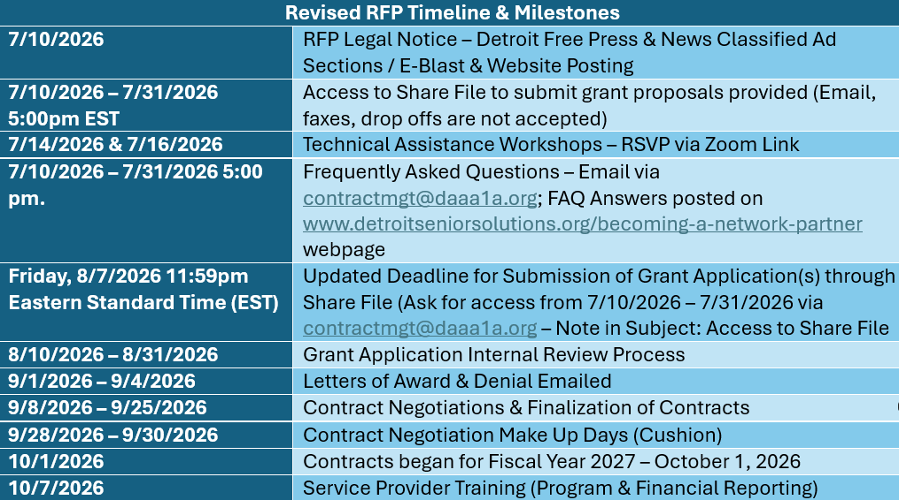
FY 2027 – FY 2029 RFP Timeline & Milestones - Updated

Slide 13
Deadlines
Proposals will be accepted up to:
  Technical Assistance and access to the ShareFile will be available until Friday, July 31, 2026, at 5:00 p.m.
  All applicants must apply through the DAAA ShareFile site – Secured Grant Portal by August 7, 2026, by 11:59 p.m. Eastern Standard Time (EST) based up the upload timestamp of the file server.
  No faxed, emailed or dropped off applications will be accepted.
  Incomplete and late applications will not be accepted.

Slide 14
Other Eligibility Criteria
Willingness to operate under a performance-based contract and comply with program and financial reporting.
Willingness to Maintain Appropriate Insurance / DAAA held Harmless.
Not Debarred from providing services by the Office of Inspector General (OIG).
Willing to have Background and Sex Offender Checks – Staff, Volunteers, Subcontractors.

Slide 15
Contract Period
Contract period will be during the FY 2027 - FY 2029 Planning & Funding Cycle on an annualized basis.
Year 1: FY 2027 - October 1, 2026 - September 30, 2027
Year 2: FY 2028 – October 1, 2027 – September 30, 2028
Year 3: FY 2029 - October 1, 2028 – September 30, 2029
Based upon availability of funding and contract compliance.

Slide 16
Program​ Funding &​
Requirements​

Slide 17
Proposal Requirements
Proposal must include:
Applications must be typed. Handwritten applications are unacceptable and will not be reviewed.
Scanned documents must be clear and legible.
Authorized personnel must sign the General Information Form and all required places (i.e. budgets).
Proposals must address published service categories only, as included and described in this RFP.
All required documentation requested in the application and listed on the application checklist must be included with the proposal.
All information provided must be properly labeled.
The applicant is required to submit completed budgets with application – Line-Item Budget and Unit Cost Form (Fee-for-Service).

Slide 18

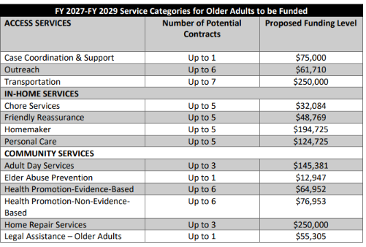
FY 2027– FY 2029 Service Categories

Slide 19
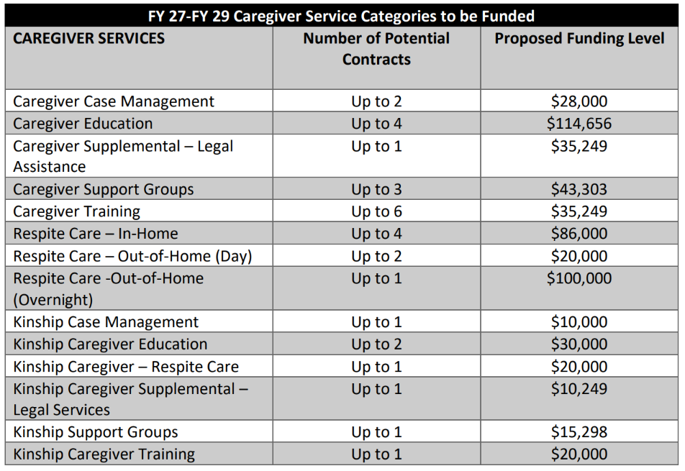
FY 2027 – FY 2029 Service Categories

Slide 20
Grant Application
General Requirements Information – Signed by Authorized Official
Section I: Agency Information
Agency Profile
Financial Management
Agency Administration
Client Grievance Procedure
Consultant Services and/or Special Partnerships

Slide 21
Grant Application
Section II: Program Information*
Program Narrative
1. Statement of Need
2. Program/Service Description
3. Program Management/Staffing
4. Program Capacity
5. Goal, Objectives, Outcomes Work Plan (with Flow Chart and/or Logic Model, if relevant)
6. Sustainability Plan & Procurement of Other Resources
*If applying for more than one service, submit one Program Information section, but label information shared by service category within each of the six sections. This will help reviewers score each application submitted.

Slide 22
Targeting Requirements
Contracted providers are required to target participants with the greatest social and economic need with an emphasis on low-income and/or minority individuals.
Participants cannot be denied or provided with limited services because of income or financial status. Key factors for prioritizing clients include: 1) social need; 2) functional need and economic need.
Contractors must have a written list of persons who seek services from a priority service category.
Contractor should use appropriate branding guide and logo and attribute funding to the Detroit Area Agency on Aging on marketing materials.

Slide 23
Grant Application
Section III: Budget
Line-Item Budget
Unit Cost Form (Fee-for-Service)
Must sign the forms requested – Authorized Official.
*Budget form must be signed by authorized official. Reference Budget
Instructions.
** Review application against proposal checklist and RFP score sheet for quality check

Slide 24
Budgets & Unit Cost Fee-for-Service
Line-Item Budget
Unit Cost Analysis Form
Local Match - 10% for new organizations and 15% for funded organizations.
Grant funds must be matched with 5% of program income.
Note Projected Clients & Units
Contracted Units X Grant Award = Grant Award
Add Required 15%* Local Match
Add 5% Program Income
Should Equal Total Budget
10% Local Match for New Organizations and 15% for funded organizations.

Slide 25
Section I Attachments
Front Page: Completed Pre-Screening Checklist
Attachment A: General Requirements Information Form
Attachment B: Section I Responses
Attachment C: Insurance Certificate and/or Listing of Insurances with Coverage Levels
Attachment D: Organizational Chart (Global)
Attachment E: Certified Audit Report or Unaudited Financial Statement Report
Attachment F: Any Audit Findings (Recent Fiscal Years)
Attachment G: IRS Form 941 with Proof of Payment
Attachment H: IRS Tax Return (i.e., Form 990 or 1120)
Attachment I: Articles of Incorporation
Attachment J: Agency’s 501 c (3) Notification Letter
Attachment K: Annual Report
Attachment L: Management / Program Staff Resumes or Job Description*
Attachment M: Grievances & Client Rights
Attachment N: Information Technology Cybersecurity Policy
  * Attachment L: Label by Service Category if different staffing is used.

Slide 26
Section II Attachments
Attachment 1: Contract Face Sheet
Attachment 2: Section II Program Information Responses
Attachment 3: Map with street boundaries and zip codes
Attachment 4: Work Plan Goals & Objectives with Flow Chart and/or Logic Models, if needed.
Attachment 5: Job descriptions of key program management staff
Attachment 6: Consultant/Contractor Agreement(s) - if relevant
Attachment 7: Special Partnership Descriptions, if relevant
Budget Forms: Detailed Budgets and Unit Cost Forms for each service category in order of Section I.

Slide 27
Links to Other Resources
MDHHS Bureau of ACLS Operating Standards for Service Programs
General Requirements Information Form
Shared File Access Instructions (removed duplicate)
Budget Forms & Instructions
Line-Item Budget
Unit Cost Form (Fee-for-Service)
Goals and Objectives Work Plan
2025 Community Needs Assessment
Vision 2026- 2030 Strategic Plan
Pre-screening Checklist
Application Scoring Form
Health Promotion/Disease Promotion Programs
Regional & Community Profiles
Insurance Compliance Form
Business Associate Agreement
Conflict of Interest Disclosure and Survey
Frequently Asked Questions

Slide 28
Specialized Services Information
Community Wellness Service Centers I Caregiving I Respite Care I Legal Services

Slide 29
Community Wellness Center Designation Requirements
Community Wellness Service Centers are community-based focal points that provide one-stop shop services to older adults and caregivers within the DAAA Service Area in addition to the requirements outline below to address the social determinants of health, social isolation and engagement of these targeted populations.
Applicants applying for funding to support designation as a Community Wellness Service Center must meet three key requirements:
National Institute of Senior Center Principles,
Provide Evidence-Based and Non-Evidenced Programs, and
Provide / Coordinate Transportation Services.

Slide 30
Community Wellness Center Designation Requirements
Applicants applying for funding to support designation as a Community Wellness Service Center must meet three key requirements: 1) National Institute of Senior Center Principles; 2) Provide Evidence-Based and Non-Evidenced Programs and 3) Provide / Coordinate Transportation Services.
NISC Principles
Nutrition support (Congregate, Home-Delivered Meals, Food Pantries)
Health and Wellness (Evidence-based and Non-Evidence-based Services)
Information & Assistance
Social & Recreational Activities
Community & Educational Resources
Access Resources (Transportation, Benefits Screening and Counseling, etc.)
Civic / Social Engagement
Supports purpose/strategic planning, community connections, governance, administration and HR, financial management, evaluation, records and reporting, accessibility of facility and robust program planning.

Slide 31
What is required to provide Evidence-Based Programs?
Identify staff/volunteers to be trained in EBP programs- at least 2-3 per program
Trained staff/volunteers must attend training and maintain certifications
Budget must include EBP training and EBP supplies
Annual Workshop Schedule - provided prior to start of fiscal year
Performance Targets-Established Benchmarks: Provide a minimum of eight (8) evidence-based classes per fiscal year with a minimum number of participants
EBP Electronic Data Collection/Submission
Quarterly CWSC Activities Report
Ability to provide workshops in-person and virtually (in case of pandemic closures)

Slide 32
Health Promotion/Disease Prevention & Caregiver Education Programs Approved for OAA Title III-D & Title III-E Funding in MI
Exercise Classes/Fall Prevention | Chronic Disease Management | Diabetes | Caregiving Education
A Matter of Balance | PATH (Chronic Disease Self-Management Program) | Diabetes Prevention Program (DPP) | Powerful Tools for Caregivers
EnhanceFitness | Chronic Pain PATH (Chronic Pain Self-Management Program) | Diabetes PATH (Diabetes Self-Management Program) | Dementia Education Series​ (Evidenced-Based Informed)
Drums Alive | Mind over Matter |  | Dementia Friends​ (Evidenced-Based Informed)
Walk With Ease |  |  | Universal Dementia
Bingocize

Slide 33
Legal Services
Applicants applying for the provision of legal assistance in DAAA’s service area may apply for the following services:
Legal Services for Older Adults
Legal Services for Caregivers
Legal Services for Kinship Families

Slide 34
Respite Care for Caregivers
Applicants applying for funding to provide respite care services to unpaid caregivers in DAAA’s service area may apply for the following services:
In-Home Respite Care
Out-of-Home Respite (day)
Out-of-Home Respite (overnight)

Slide 35
Caregiver Services
Applicants applying for the provision of caregiver services in DAAA’s service area may apply for the following services:
Caregiver Care Management
Caregiver Education
Caregiver Training
Caregiver Support Groups

Slide 36
Kinship Support Services
Applicants applying for the provision of caregiver services in DAAA’s service area may apply for the following services:
Kinship Care Management
Kinship Caregiver Education
Kinship Caregiver - Respite
Kinship Support Groups
Kinship Caregiver Training

Slide 37
Congregate Meal Site
Designation
Some organizations have inquired about becoming a Congregate Meal Site and that is a Separate Process from our RFP Bid Process.
DAAA currently has a waiting list for designating Congregate Meal sites and have made Hamtramck, Highland Park and Harper Woods priority areas.
There are a number of requirements that are put in place to become a Congregate Meal site including compliance with Federal, State and Local regulations.

Slide 38
Congregate Meal Site Requirements
Certificate of occupancy and compliance
Certificate of handicap accessibility
Building fire and safety standards and inspection report
Maintain $1,000,000 per occurrence General Liability insurance with DAAA as an added insured party
Has current copy of Food Service license
Building conditions and requirements:
  Clean bright kitchen with functioning equipment including commercial refrigeration
  Handwashing sink
  Accessible restrooms with self-closing doors
  Clean, bright, well-ventilated and barrier-free dining area and restrooms
  Enough tables and chairs for at least 10-25 people - round or square table

Slide 39

Grant Application Submission
Secure ​
Portal Tutorial ​
(Link)​

Slide 40
Quality Check
Check your application against the Proposal Check List
Review the RFP Scoring Sheet and check your application packet against it to maximize the points for your application.

Slide 41
Compliance
The successful applicant may NOT subcontract services without DAAA approval:
The successful applicant must be willing to do the following:
Delivery of services in targeted area - DAAA service area
Compliance with contract agreement
Attendance at DAAA meetings/trainings
Monthly Program and financial reporting including Mon Ami / NAPIS (Where required)
Honor HIPAA and Privacy Act for program participants
Monitor organization employees, subcontracts and other business operation partners via OIG/SAMS / Background checks
Publicity: Funding Source Credits / DAAA Logo

Slide 42
Applications After Today
REMEMBER: Technical Assistance will be provided through Friday, July 31, 2026, at 5:00pm EST by contacting ContractMtg@daaa1a.org.
Any questions asked starting July 10, 2026, through July 31, 2026, 5:00pm EST will be posted on the DAAA Website – Becoming a Network Partner page. No Technical Assistance will be provided after that date.
DAAA will post Frequently Asked Questions (FAQs) to the DAAA Website so all applicants can benefit from the responses.
Applications are due by August 4, 2026, Friday, August 7, 2026, by 11:59 p.m. EST via the DAAA ShareFile (extended).
FAQ, RFP Application Guide/Instructions, Application Templates, Forms and Reference Information can be found on the DAAA Website by visiting www.detroitseniorsolution.org/becoming-a-network-partner.
Notification of Grant Awards Status – 7 to 10 business days after Board of Directors Approvals.
Appeals – Letter of Intent to Appeal – within 10 days of Notice of Grant Award Status.
FY 2027 Service Provider Training (Compliance & Reporting) – Week of September 28, 2026

Slide 43

Q & A
Frequently Asked Questions will be posted on the Becoming-a-Network-Partner Page: www.detroitseniorsolution.org/becoming-a-network-partner

Slide 44
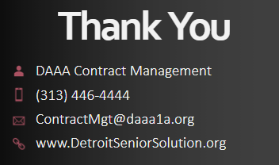

Slide 45

1333 Brewery Park Blvd., Suite 200, Detroit, MI 48207
313 446-4444
REQUEST FOR PROPOSAL TECHNICAL ASSISTANCE WORKSHOP

